Slide 1
Web Services (NSWI145) Lecture 02: Web Services Model, SOAP
Martin Nečaský, Ph.D.
Faculty of Mathematics and Physics
Charles University in Prague, Czech Republic

Slide 2
Foundations of Web Services
4 views of Web Services Architecture
Message Oriented Model
Service Oriented Model
Resource Oriented Model
Policy Model

Slide 3
Web Services Architecture
Policy Model
Policy
Service Oriented Model
Resource Oriented Model
Service
Resource
Message Oriented Model
Message

Slide 4
Message Oriented Model
Agent
Headers
originates
processes
has
Message
Message
Transport
delivers
Body
has

Slide 5
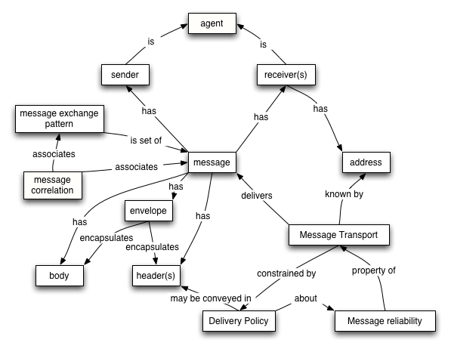
Message Oriented Model
http://www.w3.org/TR/2004/NOTE-ws-arch-20040211/#message_oriented_model

Slide 6
Service Oriented Model
Message
Person or
Organization
signals
owns
Service
describes
uses
Metadata
realizes
Agent

Slide 7
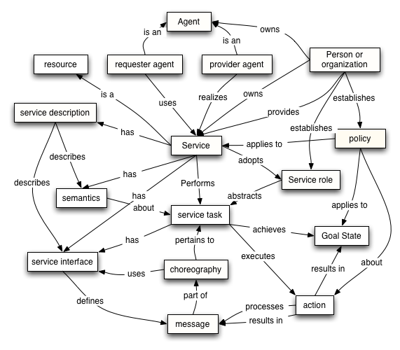
Service Oriented Model
http://www.w3.org/TR/2004/NOTE-ws-arch-20040211/#service_oriented_model

Slide 8
Resource Oriented Model
URI
Person or organization
has
owns
Resource
is
Service
may have
Representation

Slide 9
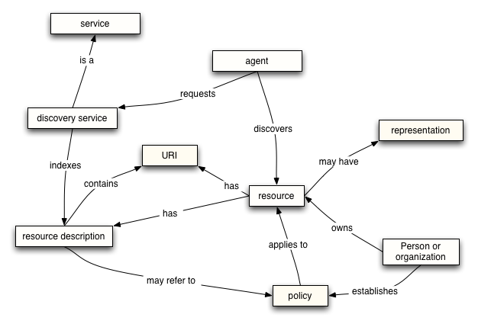
Resource Oriented Model
http://www.w3.org/TR/2004/NOTE-ws-arch-20040211/#resource_oriented_model

Slide 10
Policy Oriented Model
Action
Person or organization
about
establishes
Policy
subject to
Agent
about
Resource

Slide 11
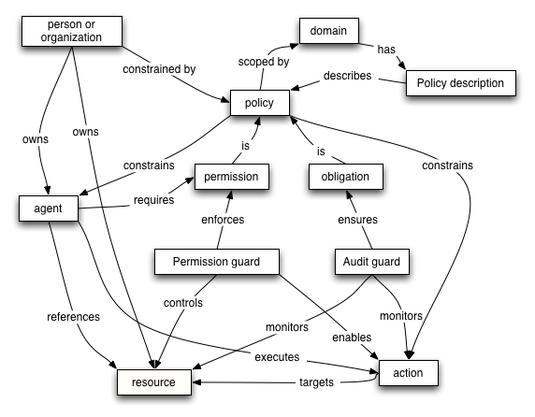
Policy Oriented Model
http://www.w3.org/TR/2004/NOTE-ws-arch-20040211/#policy_model

Slide 12
When Web Services are appropriate
for applications which must interoperate over the Internet with other applications
and, possibly, they did not originally supposed this
for applications which cannot be designed, implemented and evolved at once as one piece
for applications whose different parts run on different platforms and are owned by different persons/organizations
for applications which need to be exposed for use over the Internet
and, possibly, were not originally designated for this
where scalability, security, etc. need to be ensured

Slide 13
Foundations of Web Services
VISA
WS
MasterCard
WS
Lufthansa
WS
Travel Agent
WS
…
Turkish Air.
WS
Search Hotel
WS

Slide 14
Foundations of Web Services
Web Services advantages
platform-independence
reusability
interoperability
scalability
adaptability

Slide 15
W3C-style Web Services
Processes
XSLT
BPEL
WS-CDL
Contract
XSD
WSDL
WS-Policy
Management
Security
Messages
SOAP extensions
XML
SOAP
Communications (HTTP, SMTP, …)

Slide 16
W3C-style Web Services
WSDL
Web Service
SOAP
Interface
System
Message
Agent
Agent

Slide 17
SOAP
Basics
Syntax
Processing Model
Communication Model
Network Protocol Bindings
Advantages/Disadvantages

Slide 18
SOAP Basics
Simple Object Access Protocol
http://www.w3.org/TR/soap12-part0/
protocol for inter-application communication
applications = peers in decentralized and distributed environment

Slide 19
SOAP Basics
de facto standard protocol for communication with Web Services
easily extensible
ideal for quickly evolving Web Service technologies
overcomes differences among proprietary heterogeneous peers
absolute necessity
lightweight
no need of specific environment to be installed
no configuration necessary
“Simple Object Access Protocol” is misleading
SOAP is not Simple
SOAP is not only Object Access Protocol

Slide 20
SOAP Basics
stateless, one-way message exchange paradigm
more complex communication patterns can be created
request/response
publish/subscribe
application-specific patterns with more communication rounds or more participants

Slide 21
SOAP Message Syntax
SOAP message is XML document
envelopes exchanged data
SOAP message is transferred over network via transfer protocol
HTTP, FTP, SMTP, …
or even TCP

Slide 22
SOAP Message Syntax
Sender
Receiver
HTTP/… message
HTTP/… message
SOAP message
SOAP message
exchanged
data
exchanged
data
Network

Slide 23
SOAP Message Syntax
SOAP standardizes 3 XML elements
Envelope, Header, Body
<Envelope>
0..1
1
<Header>
<Body>
1..*
1..*
header block
body entry

Slide 24
SOAP Message Syntax
<?xml version="1.0"?>
<env:Envelope
xmlns:env="http://www.w3.org/2003/05/soap-envelope">
<!–- Header is optional -->
<env:Header>
<!–- one or more header blocks -->
</env:Header>
<!–- Body is mandatory -->
<env:Body>
<!–- one or more body entries -->
</env:Body>
</env:Envelope>

Slide 25
SOAP Message Syntax Envelope Example

Slide 26
SOAP Message Syntax - Body Entry
application specific XML element
carries application data
end-to-end information

Slide 27
SOAP Message Syntax - Body Example

Slide 28
SOAP Message Syntax - Header Block
application specific XML element
carries data that is not part of application data itself
e.g. meta-data (message addressing, security, transactions, ...)
SOAP extension mechanism
SOAP modules
SOAP faults

Slide 29
SOAP Syntax - Header Block
SOAP extensions via header blocks:
specific languages extending SOAP
WS-Encryption, WS-Trans, WS-Addressing, etc.
W3C, OASIS, etc.
each header block should have its own namespace
helps identify relevant header blocks

Slide 30
SOAP Syntax - Header Example

Slide 31
SOAP Syntax - Faults
all SOAP-specific and application-specific faults are reported using single element Fault in Body
network transfer protocol faults are reported using other protocol-specific mechanisms (e.g. HTTP)
separate SOAP message
mandatory Code and Reason
optional Detail, Node, Role

Slide 32
SOAP Syntax - Faults
Code
reports specific kind of fault
particular kind of fault may require additional header blocks to be generated
mandatory Value
contains code value
optional Subcode
contains mandatory Value with application-specific sub-code value

Slide 33
SOAP Syntax - Faults
Code | Semantics
VersionMismatch | Faulting node does not support the given version of SOAP. The node SHOULD specify how the messages should be upgraded with Upgrade header
MustUnderstand | Faulting node does not understand a header. The node SHOULD specify which header was not understood with NotUnderstood header
DataEncodingUnknown | Faulting node does not understand the message encoding
Sender | The message was incorrectly formed or did not contain the appropriate information in order to succeed. E.g. improper authentication details, registration information, etc.
Receiver | The message could not be processed for reasons attributable to the processing of the message rather than to the contents of the message itself. Something went wrong.

Slide 34
SOAP Syntax - Faults
VersionMismatch
<env:Envelope xmlns:env="http://www.w3.org/2003/05/soap-envelope"
xmlns:xml="http://www.w3.org/XML/1998/namespace">
<env:Header>
<env:Upgrade>
<env:SupportedEnvelope qname="soap1:Envelope"
xmlns:soap1="http://www.w3.org/2003/05/soap-envelope"/>
</env:Upgrade>
</env:Header>
<env:Body>
<env:Fault>
<env:Code><env:Value>env:VersionMismatch</env:Value></env:Code>
</env:Fault>
</env:Body>
</env:Envelope>
Ordered by preferences

Slide 35
SOAP Syntax - Faults
MustUnderstand
<env:Envelope xmlns:env="http://www.w3.org/2003/05/soap-envelope"
xmlns:xml="http://www.w3.org/XML/1998/namespace">
<env:Header>
<env:NotUnderstood qname="abc:ExtensionABC"
xmlns:abc="http://example.org/2011/abc"/>
<env:NotUnderstood qname="xyz:ExtensionXYZ"
xmlns:xyz="http://example.org/Martin"/>
</env:Header>
<env:Body>
<env:Fault>
<env:Code><env:Value>env:MustUnderstand</env:Value></env:Code>
</env:Fault>
</env:Body>
</env:Envelope>

Slide 36
SOAP Syntax Faults
Reason
for human understanding
contains description of fault in one or more Text elements

Slide 37
SOAP Syntax Faults Example

Slide 38
Homework 1
design your own business process
steps will be later realized as web services
one step has to be realized as an external web service, i.e. a service that is not under your control
e.g., http://wwwinfo.mfcr.cz/ares/ > Webové služby (in czech)
use BPMN to model the business process
http://www.bizagi.com or similar tool
see tutorial: http://www.omg.org/news/meetings/workshops/HC-Australia/Mancarella.pdf

Slide 39
Homework 1
in a more detail than this ...
Hospital
Reception
Investigation
Hospitalization
Surgery
Control
Economy
Material
Reports
Utility
Accommodation
Sanitary
Food

Slide 40
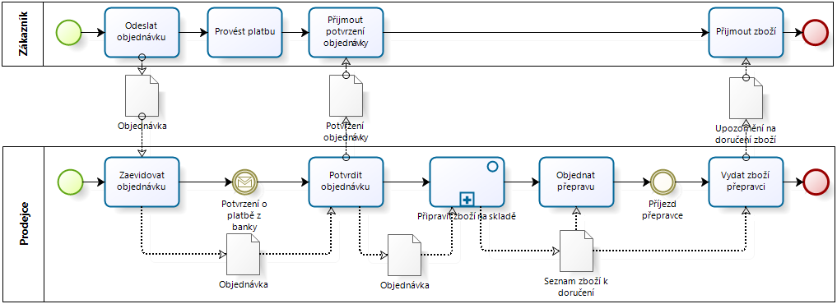
Homework 1
something like this is sufficient ...

